Slide 1
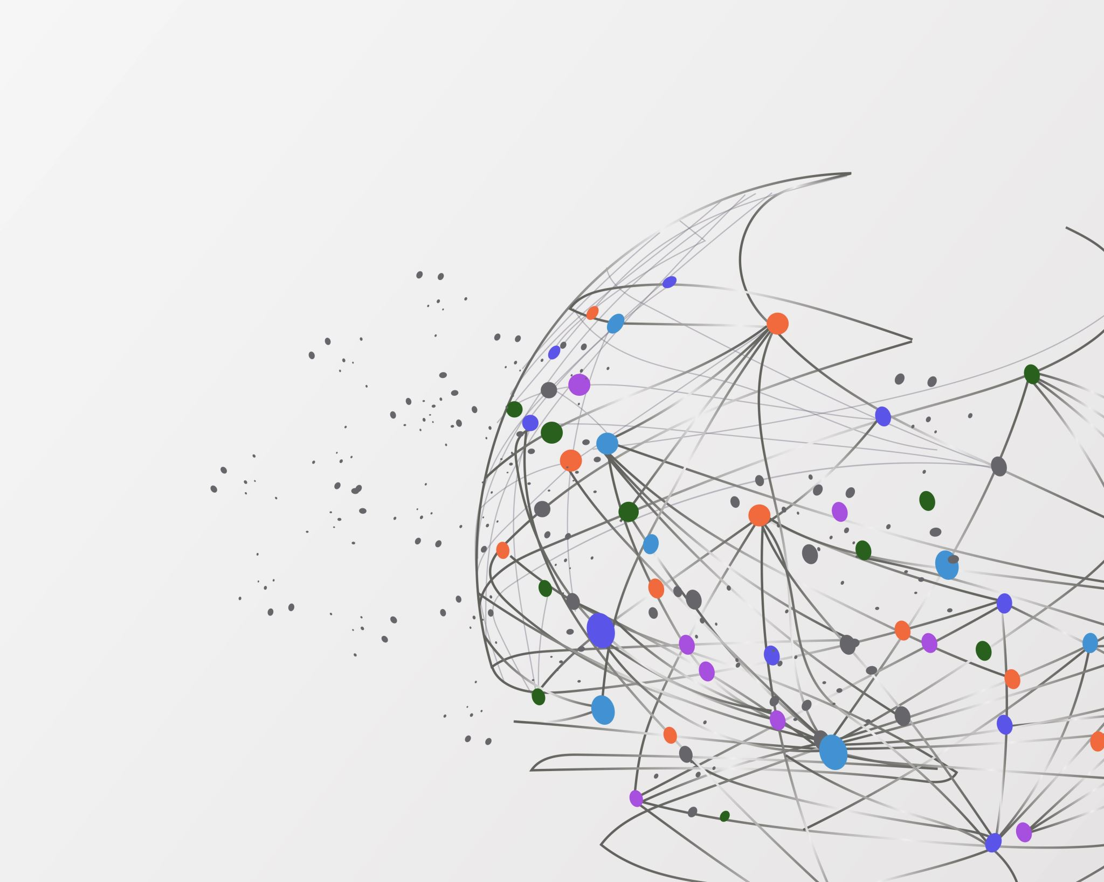
Philanthropy
Love of Humanity
Notes:
Describe why people give

Slide 2
Ways to Give
Time
Talent
Treasure

Slide 3
Trends in Philanthropy
Charity

Slide 4
Trends in Philanthropy
Charity
Improvement

Slide 5
Trends in Philanthropy
Charity
Improvement
Social Reform

Slide 6
Trends in Philanthropy
Charity
Improvement
Social Reform
Civic Engagement and Advocacy

